Slide 1
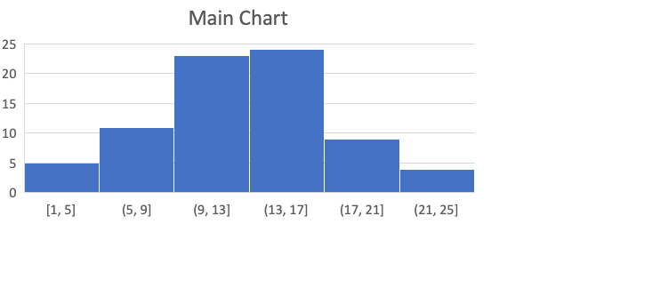

Slide 2
Please Select
All
Male
Female
Infant

